Slide 1
MAR 580: Advanced Population Modeling for Management of Living Marine Resources
Lecture 1b
Introduction to programming, why ADMB?
www.mycourses.umassd.edu
1 September 2015

Slide 2
Today’s Outline
Introduction to programming, why ADMB?
Lab exercise: Linear modeling using ADMB

Slide 3
What’s next
Fisheries Science Review
Challenges Facing Fisheries
What does EBFM have to offer?
Discussion on:
Caddy 1999
Guerry 2005
Browman & Stergiou 2004

Slide 4
Model Building, Using, Developing
In fisheries resource assessment world, typically three types of user.
Model user: take canned software and press go, limited understanding of what is happening under the hood.
Model builder: can use existing software to build alternative models, fit to new data sets, etc. A large proportion of very good practitioners probably fit under this umbrella.
Model developer: someone who is interested in developing and testing code underlying model structure and performance.
The aim of this class is to provide you with the skill set to work toward the second two of these, hopefully you are interested in the third!

Slide 5
Models in fisheries, fitting to data
Common exercise in fisheries and wildlife science is fitting a model to some data.
These models (and the data they are fit to) can be simple to more complicated.
e.g. Regressions, stock-recruitment analysis, population dynamics models, etc.
Optimization tools in statistical software (e.g. lm() or nls() in R) can be used in a lot of instances.
Custom-built objective functions can also be helpful (e.g. using optimize() in R ).
Sometimes though, these tools can be either slow, or unstable when our models contain lots of parameters or datasets become large.

Slide 6
What is AD Model Builder?
Simply put, it is a package to help conduct optimization (parameter estimation) of highly nonlinear models.
ADMB is fast.
Automatically calculates asymptotic variance estimates
Provides features for optimization (e.g. minimization of a likelihood function) and for implementing Bayesian estimation using MCMC.
Through the extension ADMB-RE, has capacity to deal very well with random effects (mixed effects models). [Ask later about TMB…]

Slide 7
What is AD Model Builder? II
ADMB has become the program de rigeur for fisheries stock assessment modeling, since the early 1990s.
Most statistical stock assessment software in use today are written in ADMB.
(e.g. ASAP, Stock Synthesis, CASAL, etc.)
ADMB you write a template file that contains your model specification, and how the data relate to the model (objective function).
You need to specify the objective function, but ADMB takes care of the minimization procedure (you don’t have to write that. Fear not, numerical methods shall feature heavily in a future course!)

Slide 8
Types of programming languages
Generally fall in to one of two categories
Interpreted languages immediately execute commands, allow you to instantly
Source code (what you write) vs machine code (what computers process).
Compilers take your source code and turn it into object code that can be used by the processor, and create an executable that can run this code.
Compiled languages are written in a code that can be executed directly on a computer’s processor. This is because a compiler has translated the code into the computer’s “native” language up front, well before the program is even run. This process can take many passes before it is optimized as machine code, but the output is always code that’s ready to be executed—and that executes efficiently, as a result.
Interpreted
Compiled

Slide 9
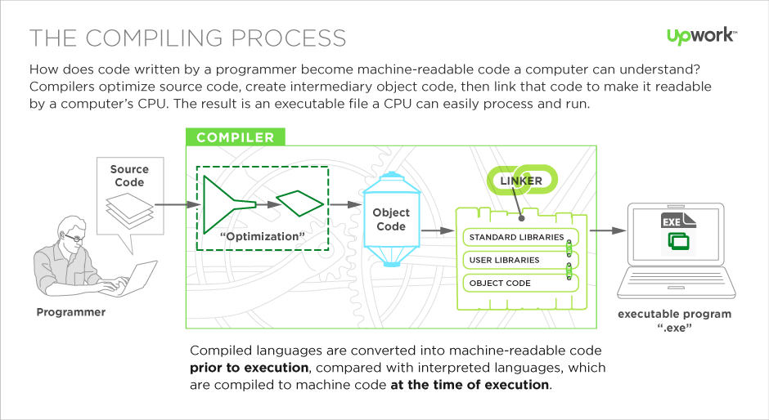
http://www.upwork.com

Slide 10
ADMB is a compiled language
In fact, it is a little different.
In ADMB you write and ADMB template (.tpl) file.
The compiler first turns this into C++ code (the .tpl is pseudo C++), which is then compiled by a C++ compiler and linked to ADMB libraries to make the executable.

Slide 11
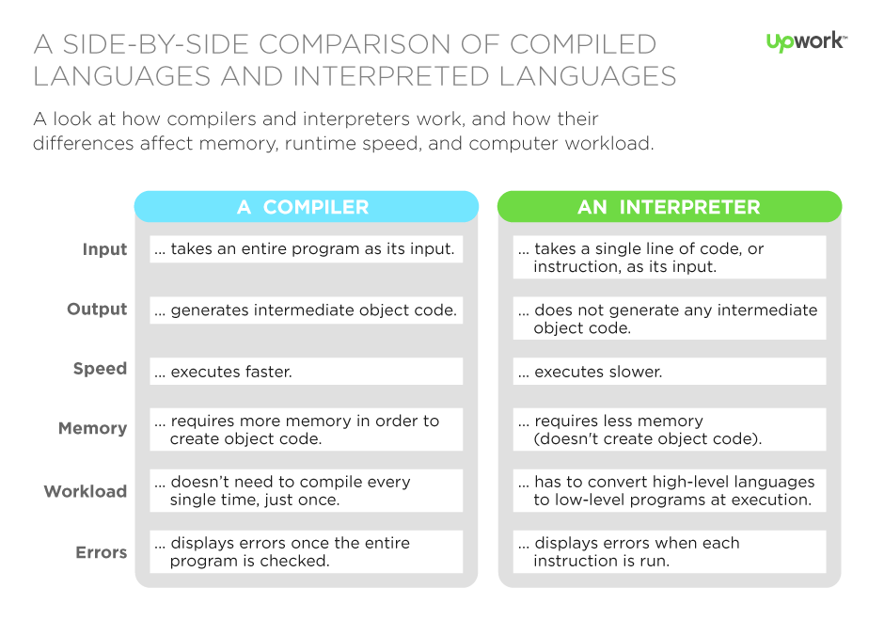
http://www.upwork.com

Slide 12
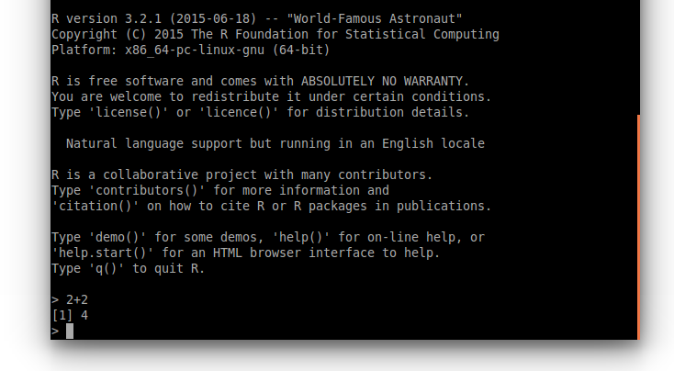
R is an example of an interpreted language.
Typing 2+2 into the command prompt gives the result instantly. The code is executed as it is parsed.

Slide 13


Slide 14
Reading
Fournier, D.A., H.J. Skaug, J. Ancheta, J. Ianelli, A. Magnusson, M.N. Maunder, A. Nielsen, and J. Sibert. 2012. AD Model Builder: using automatic differentiation for statistical inference of highly parameterized complex nonlinear models. Optim. Methods Softw. 27:233-249.

Slide 15
Additional Resources
Reference Card
http://www.admb-project.org/documentation/refcards

Slide 17
Very simply – you are going to:
Give your computer a set of instructions, specifically find the hypothesis that best explain your data based on your likelihood rules.
Your instructions are written in ADMB format.
Because your computer doesn’t know ADMB speak, you use ADMB libraries/dictionaries to translate your instructions in to computer language.
Then the computer will use your translated instructions and the ADMB dictionaries to get the answer you want/need/hope for.
The library that your computer translator uses to change ADMB instructions into computer instructions is not smart, so you have to be precise in your programming.
ADMB is now used by thousands people in dozens of fields. Learning it will make you very marketable in the workplace.

Slide 18
Specifying the Problem
ADMB programs are written using a template (a file with a .TPL extension).
The TPL file specifies:
the function to be minimized ;
the parameters that are to be varied to minimize the function;
any variables that depend on the parameters but are not parameters themselves; and
the data (constants) that are part of the function.

Slide 19
The ADMB “Approach”
Create a .TPL file. This file provides the specifications to:
read in the data;
identify the parameters and any derived variables;
define the model; and
define the objective function to be minimized.
Convert the TPL file to a C++ file (a CPP file) using tpl2cpp.exe.
Compile and link the resultant C++ program as you would any other C++ program.
The ADMB documentation is very terse but can be helpful – consult it!

Slide 21
The First Example - I
We start with a least-squares problem:
Find a and b by minimizing:
Program: LECTA.TPL
Data File: LECTA.DAT
To compile: admb LECTA
To run: LECTA
Have a look at the various output files.

Slide 22
The First Example - II (Linear Regression)
Sections:
DATA – the input data (read from
LECTA.DAT)
PARAMETER – the model parameters, any
functions of the parameters, and the
objective function.
PROCEDURE – where the calculations are
done
There are other SECTIONS which will come
later.
DATA_SECTION
init_int NData;
init_vector x(1,NData);
init_vector y(1,NData);
PARAMETER_SECTION
init_number a;
init_number b;
vector ypred(1,NData);
objective_function_value obj_fun;
PROCEDURE_SECTION
ypred = a + b*x;
obj_fun = norm2(y-ypred);

Slide 23
The First Example - III (Linear Regression)
Reserved words:
To specify storage types (in blue)
To specify built-in functions (in green)
DATA_SECTION
init_int NData;
init_vector x(1,NData);
init_vector y(1,NData);
PARAMETER_SECTION
init_number a;
init_number b;
vector ypred(1,NData);
objective_function_value obj_fun;
PROCEDURE_SECTION
ypred = a + b*x;
obj_fun = norm2(y-ypred);
// This is a comment
catch is a reserved word!!
Some notes:
You can add comments (lines starting
with //) – use them!
ADMB works with vectors – see how
the predicted values are computed.
The “objective_function_value” is the
variable being minimized.

Slide 24
Our First Example - IV (Adding output)
DATA_SECTION
init_int NData;
init_vector x(1,NData);
init_vector y(1,NData);
PARAMETER_SECTION
init_number a;
init_number b;
vector ypred(1,NData);
objective_function_value obj_fun;
PROCEDURE_SECTION
ypred = a + b*x;
cout << ypred << endl;
obj_fun = norm2(y-ypred);
// This is a comment
REPORT_SECTION
report << ypred << endl;
report << y << endl;
Use:
“cout” to output the values for variables to the screen; and
“report” to output results to the .REP file (only after the minimization is complete)

Slide 25
The First Example - V (Output Files of Interest)
LECTA.PAR – lists the parameter estimates, the final objective function, and the gradient – the latter should be close to zero!
LECTA.STD – lists the parameter estimates and the (asymptotic) standard errors.
LECTA.COR – lists the parameter estimates, their (asymptotic) standard errors, and their (asymptotic) correlation matrix.
LECTA.REP – lists any variables specified in the REPORT_SECTION.

Slide 26
This Problem Could Have Been Done in EXCEL using SOLVER!
Note: I had to run SOLVER twice
to get the real solution

Slide 27
Dissecting The Program (arithmetic)
ypred = a + b*x;
obj_fun = norm2(y-ypred);
The first line is a vector operation - it defines a vector, each element of which, ypred(i), is a+b*x(i).
The second line sums the squares of the differences between the observed (y) and predicted (ypred) values – this is also a vector operation.

Slide 28
Something About Arithmetic
The following are the ADMB arithmetic expressions:
Z=a+b – addition (note Z+=b)
Z=a-b – subtraction
Z=a*b – multiplication
Z=a/b – division
ADMB implements all the standard functions (and more):
Z=log(a)
Z=mfexp(a)
Z=pow(a,b) – exponentiation
Z=square(a)
Z=norm2(vec1,vec2)

Slide 29
Declaring Variables
Before a variable is used, it has to be declared.
Key distinction among variables:
Fixed throughout the program (data to be read in, values for fixed parameters, e.g. Survival) – declare in the DATA_SECTION.
The parameters to be estimated and any variables that are functions of these parameters – declare in the PARAMETER_SECTION.
Declarations are of the form:
“Data type” “variable name”;
Notes:
Not at the local level
CITES listings

Slide 30
Data Types
ADMB needs to know what dimensions and format your data/variables/parameters will be in!
The most-basic types:
int (e.g. int Count) – integer.
number (e.g. number Biomass) – real number.
vector (e.g. vector me(1,10)) – set of real numbers indexed by 1,2,..,10.
ivector – as for vector, except that the contents are integers.
matrix – two dimensional array of real;
imatrix – two dimensional array of integer;
3darray – three dimensional array of real; and
4darray – four dimensional array of real
All variables MUST be declared before they are used – no exemptions!

Slide 31
Variable Names-I
Variable names:
Must start with an alphabetic character.
Don’t use any reserved words (if, else, etc.)
Choose descriptive but not overly long variable names (e.g. biomass, MSY).
ADMB (and C) is case-sensitive, i.e. the variables biomass and Biomass are NOT the same variable.

Slide 32
Variable Names - II
Other rules / hints:
Use underscores to split names within a variable name (e.g. my_biomass).
Avoid re-using the same variable for different purposes.
Don’t forget those semi-colons!

Slide 33
Review I
This workshop is centered around three principles of modeling
Formulation
The model -
Likelihoods -
Implementation
You learned what a template file is
Your template contains specific instructions about data, parameters, variables, and the objective function
You learned that ADMB code gets translated to machine code
Evaluation
Likelihoods
Residual diagnostics
Management risk

Slide 34
Commands and Functions
Fish 559; Day1: 13h00-15h30
Notes:
a

Slide 35
Very simply – you are going to:
Learn how to write ADMB instructions. Just like English is different from Spanish, ADMB is different from R.
Although the languages are different, they share many of the same words and a lot of the same punctuation.
Unfortunately, you are not writing novels. The only artistic freedom you have is with your description of nature, the format of your instructions is pretty set in stone.
Now you will learn syntax and format for writing your ADMB code.

Slide 36
Programming the Procedure Section-I (The “If” statement)
All the normal C++ statements can be used in the Procedure Section:
The if statement:
if (condition)
Statements-1;
else
Statements-2;
Combining statements:
{ statement; statement }

Slide 37
Programming the Procedure Section-II (Constructing conditions)
RELATIONAL OPERATORS:
= = Equal to (NOT =)
<= Less than or equal to
>= Greater than or equal to
< Less than
> Greater than
!= Not equal to
LOGICAL OPERATORS:
&& Condition is true if both sub-conditions are true
|| Condition is true if one of the sub-conditions is true
! Condition is true if sub-condition is false
Note: ADMB may not work if a parameter or derived variable appears in an condition.

Slide 38
Programming the Procedure Section-III (The For statement)
for (initial state; terminal condition; increment)
{ statements }
Initial state: Usually involves setting a “loop control variable” to some initial value.
Terminal condition: The loop will run until this condition is TRUE (note it need not involve the “loop control variable”.
Increment: This usually involves updating the “loop control variable” (e.g. X++; X--).
Note: Parameters and derived variables should not appear in the terminal condition.

Slide 39
Programming the Procedure Section-IV (The For statement)
Biomass(1) = 1;
for (Year=1; Year<=Nyear; Year++)
Biomass(Year+1)=Biomass(Year)*r;
What does “for(;;;)” do???

Slide 40
Arrays, Matrices, and 3d-arrays
Arrays, matrices, and 3d-arrays behave the same way as a mathematical vector.
You can reference whole arrays or elements of arrays (the former is generally faster).
We will often use arrays in conjunction with “for” loops.

Slide 41
Built-in Functions in ADMB-I (Mathematical functions)
Default functions:
sin, cos, asin, atan, acos, sinh, cosh, tanh, fabs*, exp, log,
log10, sqrt, pow, gammln, log_comb
These functions operate on numbers and vectors, i.e:
number = exp(number); vector = exp(vector)
One can also find the minimum and maximum of a vector: min(x)*; max(x)*
* Are these differentiable?

Slide 42
Built-in Functions in ADMB-II (Vector & matrix functions)
c = elem_prod(a,b):
c = elem_div(a,b):
matrix_b = det(matrix_a) – determinant
matrix_b = inv(matrix_a) – inverse
number_a = norm(x):
number_a = norm2(x):
matrix_b = trans(matrix_a) - transpose

Slide 43
Built-in Functions in ADMB-III (Extraction functions)
Extracting from arrays and matrices:
vector = column(matrix,index)
vector = extract_row(matrix,index)
vector = extract_diagonal(matrix)
Subvectors: extract a subset of a vector:
vector2 = vector1(ivector)
vector2 = vector1(index1,index2)

Slide 44
Built-in Functions in ADMB-IV (Statistical functions)
Statistical functions (cumulative normal):
cumd_norm, inv_cumd_norm
Random number generators (first create a “random number generator class” – specifies the random number seed; then use it), i.e.
random_number_generator r(1891);
Poisson = randpoission(lamda, r);
Normal = randn(r);
Uniform = randu(r);
Vector and matrix versions of these routines exist.
Create the class
Use it!

Slide 45
Functions and crashes
Nothing causes ADMB more problems than:
IF statements; and
Functions that have very large derivatives.
Discontinuous functions or functions which are “bumpy”
How to overcome keeping a variable (x) positive (and differentiable):
Use posfunc(x, eps, penalty)
x = sqrt(x*x);

Slide 46
FUNCTIONs-I
FUNCTIONS are part of the PROCEDURE_SECTION.
Why functions?
We often wish to break the evaluation of the objective function into sub-components (which we may wish to call several times).
We can insert (commonly-used and tested) functions “straight” into a new program.

Slide 47
FUNCTIONs-II (an example)
PROCEDURE_SECTION
// Set the fixed values
SetFixed();
// Calculate the N matrix
InitialN();
// Find the Index Likelihood
Index_Likelihood();
// Find the age-composition likelihood
if (CAAESS > 0) Age_Likelihood();
// Find the length-composition likelihood
if (NLLESS > 0) Length_Likelihood();
FUNCTION SetFixed
Code
FUNCTION InitialN
Code
These are function calls
– note the need for “()”
This the BODY of the function SetFixed – note the need for the word FUNCTION

Slide 48
FUNCTIONs-III (passing parameters)
Most computer languages (including C++) allow parameters to be “passed” between a calling program and a function.
This is to be avoided when using ADMB (an exception to this will be discussed later).
To make a variable common to all functions, declare it in the DATA_SECTION (input data or functions of the input data; any integer values) or the PARAMETER_SECTION (variables that depend on the model parameters).

Slide 49
Declaring Variables in the PROCEDURE_SECTION
You will often need “temporary” variables in the PROCEDURE_SECTION or the REPORT_SECTION. These can be declared by adding:
“int variable_name” for an integer;
“dvariable variable_name” for a real;
“dvar_vector variable_name(a,b)” for a vector.
at the start of a FUNCTION.

Slide 50
Commands in other Sections
Standard C++ commands can be used in the PROCEDURE, REPORT and PRELIMINARY_CALCS sections.
To use standard C++ commands in the DATA and PARAMETER sections use either:
!! Statement;
LOCAL_CALCS
Statements;
END_CALCS

Slide 51
Hints: Debugging
ADMB code is NOT easy to debug:
If you run the DOS version of the compiler, the error messages relate to the CPP file and NOT the TPL file.
Watch for errors during the TPL2CPP phase of the compilation.
Use “cout” to output variables to the screen so you can check that the function is being calculated correctly.
I often test code by running it with no variables being estimated (just an objective function equal to dummy*dummy where dummy is a new variable that does not appear in the model). This allows me to check the calculations “by hand”.

Slide 52
Programming Style
Comment, comment, comment:
Always include a comment (indicated by “//”) at the start of the program that states what it does.
Split ideas / blocks of code with blank lines and comments.
Use “inline” comments to refer to equations and meanings of variables.
Indent blocks of code to increase clarity.
Include comments in your data files (indicated by “#”).

Slide 53
Programming Hints
Start simple: develop a routine, test it, develop the next routine, …
Use cout: test code by writing out intermediate results (you should then check that the values output are correct given the values for the parameters – the first call of the function will involve the parameters being set to their initial values).
Cross compare: Write critical bits of code in EXCEL or R and check you get the correct function value.
Never, ever, ever, believe your code is correct: always work on the assumption there is an error there somewhere!

Slide 54
The Example Problem-I
Fit the dynamic Schaefer model to the catch and effort data for Cape hake off the west coast of South Africa.
The data are located in the file LECTB.DAT

Slide 55
The Example Problem-II
DATA_SECTION
init_int Fyear;
init_int Lyear;
init_vector Catch(Fyear,Lyear);
init_vector CPUE(Fyear,Lyear);
INITIALIZATION_SECTION
logr -0.6
logq -9
logK 8.5
PARAMETER_SECTION
init_number logr(1);
init_number logq(1);
init_number logK(1);
number r;
number q;
number K;
vector Bio(Fyear,Lyear+1);
objective_function_value objn;
First and last years, and the catch and CPUE data
Parameters in log-space
to prevent negative values
Temporary variables

Slide 56
The Example Problem-III
PROCEDURE_SECTION
int Year;
dvariable SS;
r = mfexp(logr); q = mfexp(logq);
K = mfexp(logK);
Bio(Fyear) = K;
for (Year=Fyear;Year<=Lyear;Year++)
{
Bio(Year+1) = Bio(Year) +
r*Bio(Year)*(1.0-Bio(Year)/K) - Catch(Year);
if (Bio(Year+1) < 1) Bio(Year+1) = 1;
}
SS = 0;
for (Year=Fyear;Year<=Lyear;Year++)
if (CPUE(Year) > 0)
SS += square(log(q*Bio(Year)/CPUE(Year)));
objn = SS;
cout << SS << endl;
Change for
negative values

Slide 57
Review I
This workshop is centered around three principles of modeling
Formulation
The model -
Likelihoods -
Implementation
You learned ADMB has specific syntax and templates
Be consistent with how you name and code, and use comments.
Just like someone who writes a lot of runon sentences using and, or a teenager who always says like, using if makes it difficult for ADMB to operate. Limit your if statements.
You’ve now seen a couple of ADMB template examples.
Evaluation
Likelihoods
Residual diagnostics
Management risk

Slide 58
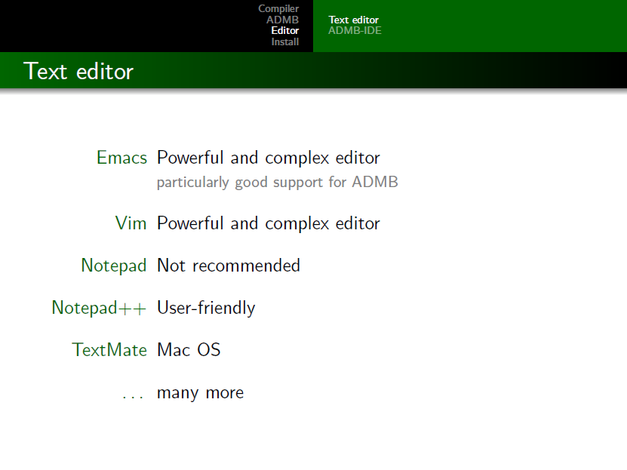

Slide 59
